Slide 1
Crossroads of America Council
Indianapolis
IN

Slide 2
Your Popcorn Team
Crossroads of America Council
District Kernel: Name; (123) 123-1234; Email
District Kernel: Name; (123) 123-1234; Email
District Kernel: Name; (123) 123-1234; Email
District Kernel: Name; (123) 123-1234; Email
District Kernel: Name; (123) 123-1234; Email

Slide 3
Your Popcorn Team
Crossroads of America Council
Council Staff Advisor: Doug Band; (317) 813-7131; doband@crossroadsbsa.org
Council Asst Staff Advisor: Jordan Sandoe; (317)-813-7125: jorsand@crossroadsbsa.org
Council Kernel: Mike Pell; (708) 218-8865; pelongo@gmail.com
Council Customer Service: Cindy Grimes; (317) 813-7091; popcorn@crossroadsbsa.org
Trail’s End Sales Manager: Adam Walden; (317) 432-6899; adam.walden@trails-end.com
More Resources & Support Available at…
Trail’s End Customer Service: support@trails-end.com
Trail’s End Facebook Group: Text FACEBOOK to 62771

Slide 6
Why Popcorn?

Slide 8
Message to Parents
No out-of-pocket-expense to enjoy 12 months of Scouting activities
Do one fundraiser a year; more time to enjoy Scouting
Scouts ...
Earn their own way
Learn life lessons and responsibility
All Scouts will enjoy the Unit’s program
Consumers are motivated to purchase based on the cause
We should ask our Scouts and parents to go out and be confident that our communities WANT to support Scouting. They will IF we ask them to.

Slide 9
Unit Popcorn Kickoff
The single most important thing is… ENTHUSIASM! Find ‘that’ person!
Dress up the room, pop popcorn, and have games for Scouts.
Role play a “sale” either at a storefront or at the neighbor’s door.
Families should walk out excited, informed, and ready to sell.
Train Both Scouts AND Parents (different messages).
Promote the Scout Popcorn Festival on Aug 13 for more training!
Make account registration part of your kickoff
Pick a location that has access to Wi-fi and ask parents to bring a tablet or smartphone (have extra laptops available if possible)
Walk parents through the quick steps of registration, and run through the ways to share the personalized fundraising page

Slide 11
A Successful Sale

Slide 12
A Successful Sale
Always wear your uniform, where appropriate.

Slide 14
Ways to Sell

Slide 15
2022 Trail’s End Tech

Slide 16
Unit Leader Portal
The Unit Leader Portal is now mobile-friendly where Units can access the portal while at a storefront or on the go.
Units can manage their entire sale from their phone.
Note: The Trail’s End App is just for Scouts. You will access the Unit Leader Portal at www.trails-end.com through the browser on your mobile device, not through an App.

Slide 17
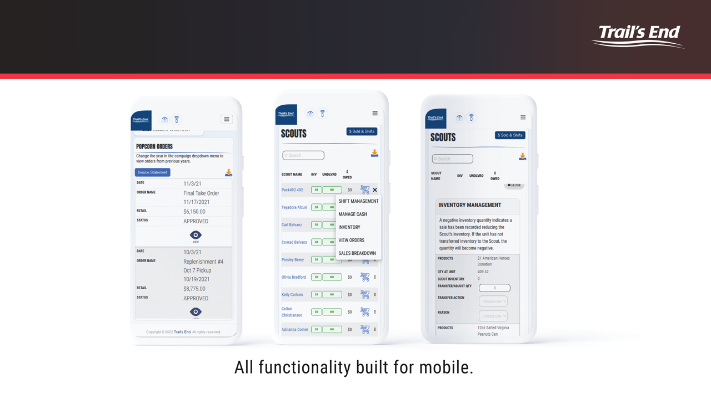
Unit Leader Portal

Slide 18
Trail’s End App

Slide 19
Trail’s End App

Slide 20
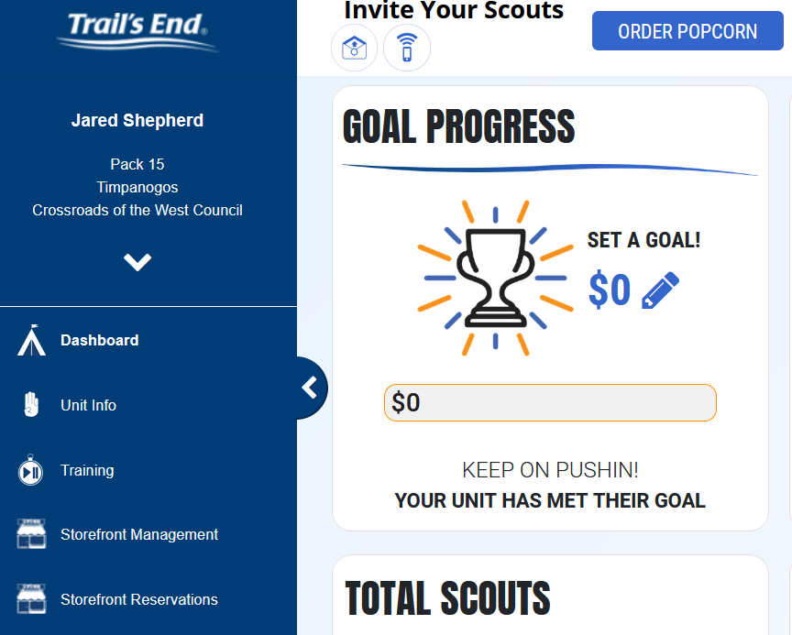
Trail’s End Storefronts

Slide 21
Trail’s End Storefront Scheduling
27,000 Hours Booked!
Kroger locations available September 23-25

Slide 22
Reserving Storefronts
Mon 7/18 Top Selling Units (sold $10k+ last year), 1 pick in district
Tue 7/19 Top Selling Units (sold $10k+ last year), 2 picks in district
Wed 7/20 All Units, 1 pick in district
Thu 7/21 All Units, 2 picks in district
Fri 7/22 All Units, 4 picks in district
Sat 7/23 All Units, unlimited picks in Council

Slide 24
Trail’s End Webinars
Registration site is open for training!
New and existing unit kernels are encouraged to attend.
First session launches on July 9.
Register at:
https://www.trails-end.com/webinars

Slide 25
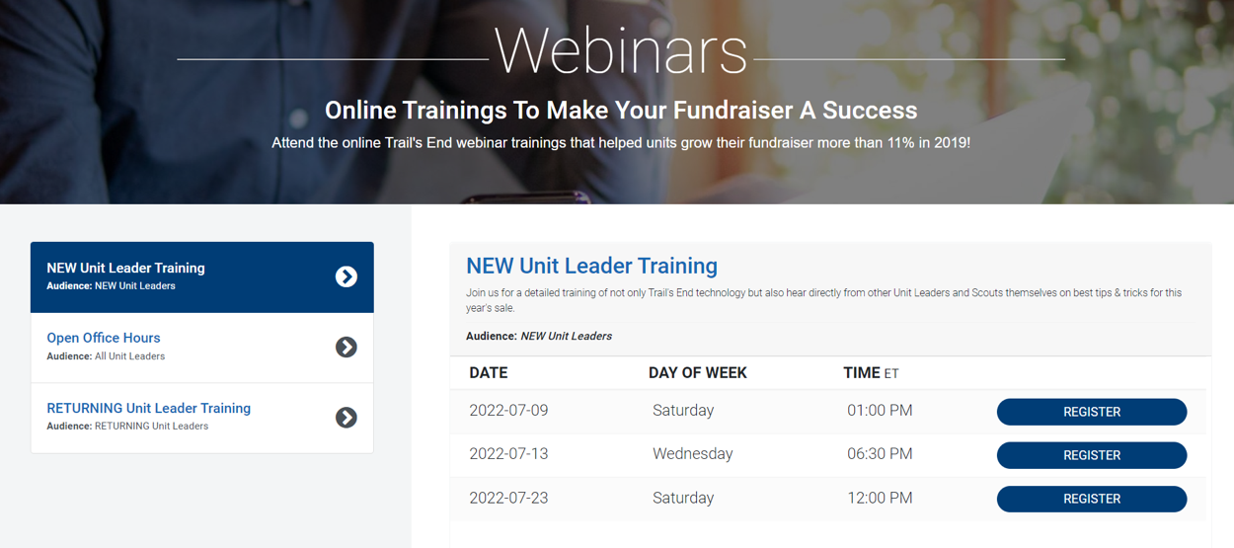
Trail’s End Webinars

Slide 26
Open Office Hours
Have a question or a few?
Swing by our Trail's End Popcorn Community Facebook page every Wednesday starting Wednesday, July 27th at 7pm EST through Wednesday, November 9th at 7pm and we'll be LIVE to help answer any questions that come through.
Open office hours are in addition to the Customer Support email + Social Media platform support outlets provided.

Slide 29
Council Bonus Experience
TOP 20 SELLING SCOUTS
DAVE & BUSTER’S
Recognition
Food
Games
Top 1-2 from the district if 1 Scout does not make the top 20 in the council

Slide 31
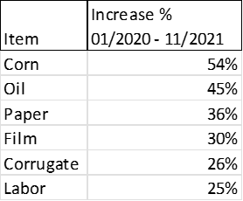
Economic Factors
Product cost increases since January 2020:

Slide 33
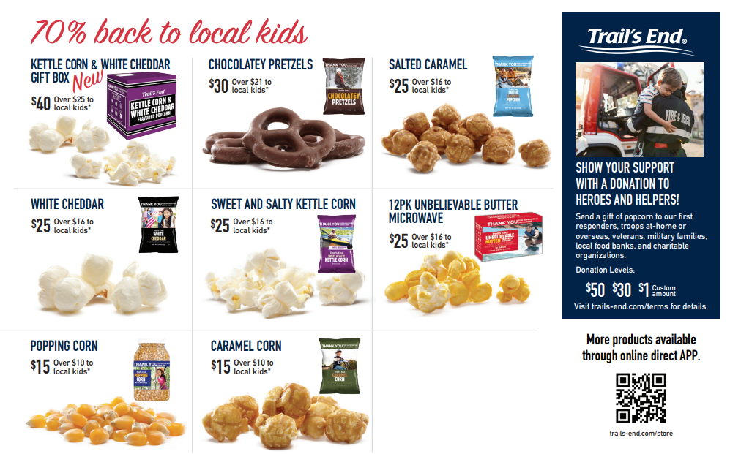
Traditional Products
Notes:
include

Slide 34
Additional Online Products *
Agenda
* Providing supply chain issues are minimized
Notes:
include

Slide 35
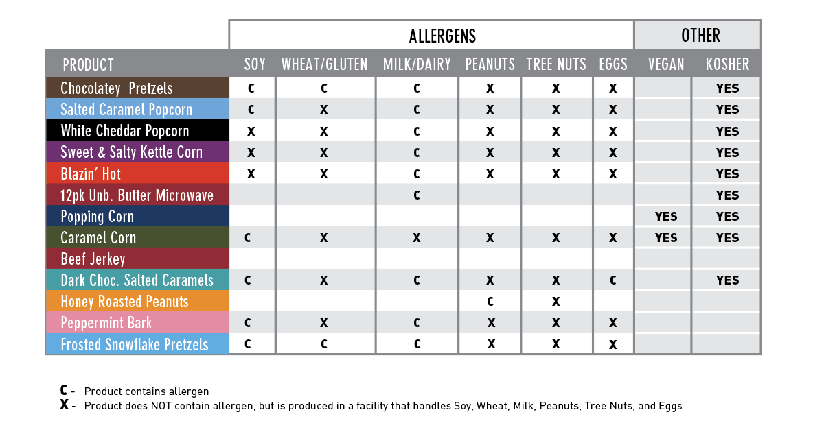
2022 Product Allergens
Notes:
Download Unit Accounts Receivable. Sum column N and divide it by the sum of column K.

Slide 37
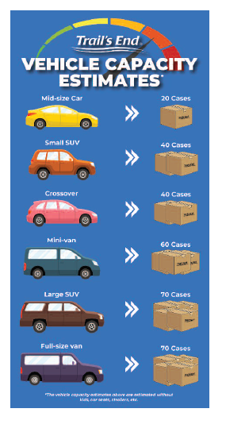
Ordering

Slide 38
Distribution Sites for Initial and Final Order
Key Dates
Community Christian Church 3672 Western Ave, Connersville IN
Distributors Terminal 1441 Aberdeen St., Terre Haute IN
Fischar Inc. 3387 S 375 E, Shelbyville IN
IDS Warehouse 9431 Allpoints Pkwy, Plainfield IN
Second Harvest Food Bank 6621 N. Old State Rd., Muncie IN
SMC 10100 SMC Blvd, Noblesville IN

Slide 40
Key Dates
7/31: Initial Order due
8/13: Scout Popcorn Festival at Camp Belzer from noon-4:00
8/19: Initial Order pick-up
Sundays by midnight: Weekly Replenishment Orders due
Thursdays: Replenishment pick-ups at IDS and Camp Belzer
10/23: Final Order due
11/10: Final Order pick-up
11/10: Final Payments and Rewards Orders due

Slide 41
Key Dates
Weekly Replenishment Orders
Aug 28 Replenishment #1 (pick-up on Sep 1)
Sep 4 Replenishment #2 (pick-up on Sep 8)
Sep 11 Replenishment #3 (pick-up on Sep 15)
Sep 18 Replenishment #4 (pick-up on Sep 22)
Sep 25 Replenishment #5 (pick-up on Sep 29)
Oct 2 Replenishment #6 (pick-up on Oct 6)
No returns: please replenish inventory as you go and use unit-to-unit transfers as needed.

Slide 42
Commission Structure
Commission Type: | Commission Percentage:
Traditional | 33%
5% Sales Growth Over 2021 | 2%
Sell $20k - $29,999 | 2%
Sell $30k - $39,999 - OR - | 3%
Sell $40k+ - OR - | 4%
Online Direct | 35%

